Slide 1



Step 1: Identify most significant climate drivers
candidate climate drivers (CRU monthly)
T GROUP
PPT GROUP
CLOUD GROUP
spline-detrended ∆r or ∆AGB
mean T
min T
max T
PET*
daily T range
% cloud cover
PET*
precipitation
n precip days
∆r
x
climwin
top climate drivers:
top driver in each of 3 groups,
optimal time windows
y: residuals
AIC
remove any redundancy w.r.t. PET(*) or collinearity
Step 2: Combine DBH, climate, and environmental drivers in GLS model
2-3 independent top climate drivers
reconstructed DBH
atmospheric pollution
driver variables
GLS model
species random effect
simultaneous detrending with spline on year (by individual)
CO₂ SO₂ NO_{x}
x
(placeholder)
(plot w/o spline)
∆r
y

Slide 2
Traditional analysis
Variable identification in Climwin
GLS output
(a)
(b)
(d)
(f)
(c)
(e)
15 10 5 0
____________________________________________
months prior to current August

Slide 3
legend
by
site
and
species
(hopefully
manageable)
∆AGB (Mg)
∆r (mm)

Slide 4
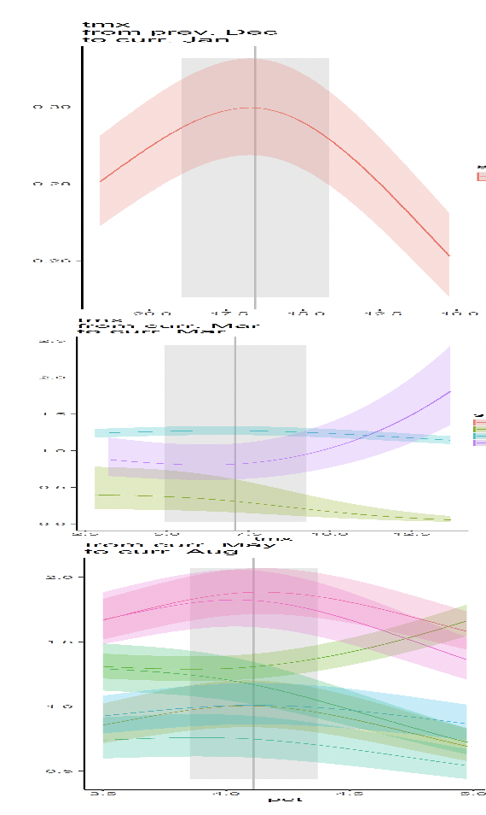
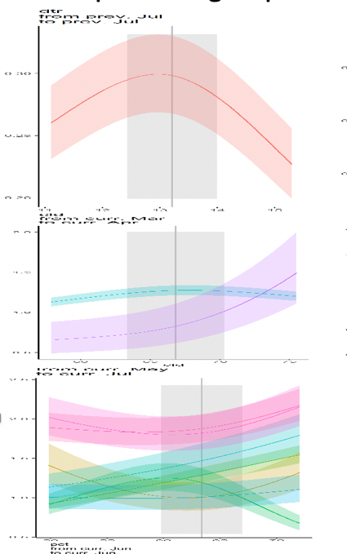
Precipitation group
Temperature group
Cloud group
Species legend
Site (ordered by latitude)

Slide 5
∆r
BAI
∆AGB
Notes:
Current example (June 7, 2020): PET at Lilly Dickey

